Slide 1
Best Practices in Template Design and Reuse with SharePoint Designer 2010
Notes:
SharePoint Designer 2010 is a very powerful tool with many more capabilities than previous versions. With this power comes the responsibility of making sure that the right changes are being made and that they are being done with reuse in mind. In this module you’ll learn how to best utilize SharePoint Designer 2010 and how to properly integrate it into your environment.

Slide 2
Agenda
SharePoint Designer Deployment Plan
SharePoint Designer Permissions
Site Components Creation
Workflows
Site Packaging

Slide 3
Deploying SharePoint Designer 2010
Can be downloaded directly from Microsoft’s website
Best to inform user base to wait until they get a “clearance” from IT before downloading & installing
Notes:
SharePoint Designer is a free application and can be downloaded directly from Microsoft’s website. However, it is essential for organizations to plan out who should download it and be given access to use it on SharePoint sites. Technically, the download of product cannot be blocked, but it is useless without the person having the proper permission to use it. More on permissions in another slide.

Slide 4
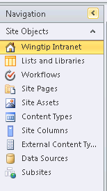
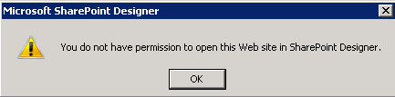
SharePoint Designer Default Experience for Various Access Levels
Site Administrators and Designers
No access to Master Pages
No access to manage website hierarchy
Readers and Members
Notes:
SharePoint Designer (SPD) is used to create and manipulate components of SharePoint. It is not meant for working with ‘data’ in SharePoint. For example, management of data in lists, libraries and pages is still performed using the browser by end users and members of the site.
Readers and Members of the site do not have any access to manage SharePoint sites using SharePoint Designer.
Site Administrators and Designers have limited rights by default. These can be raised depending on the need. More on next slide.

Slide 5
Agenda
SharePoint Designer Deployment Plan
SharePoint Designer Permissions
Site Components Creation
Workflows
Site Packaging

Slide 6
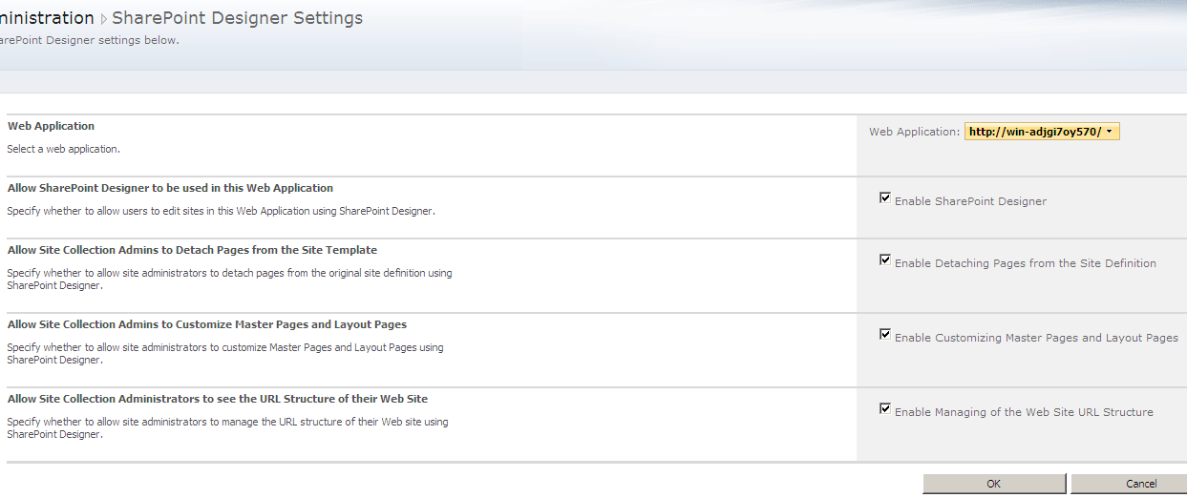
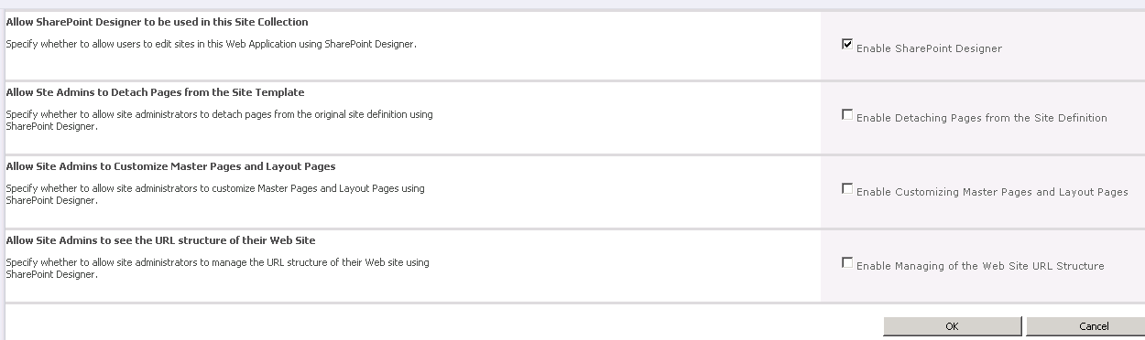
SharePoint Designer 2010 Usage Permission Levels
Notes:
SharePoint Designer is meant to be used by Designers, Site Administrators, Power Users, Developers and IT Professionals.The usage setting (essentially security) for SPD can be configured by a Server Administrator at the Web Application level for all Site Collection Administrators. Also, a Site Collection administrator can control the access for Site Administrators.
Only raise permission as much as needed for a group. Just like any other powerful application, SharePoint Designer also has the capability to be used improperly which could have adverse effects in your environment.

Slide 7
Agenda
SharePoint Designer Deployment Plan
SharePoint Designer Permissions
Site Components Creation
Workflows
Site Packaging

Slide 8
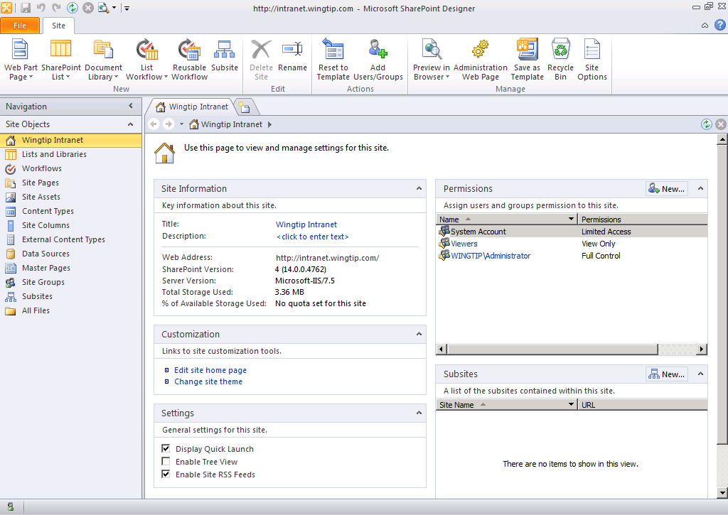
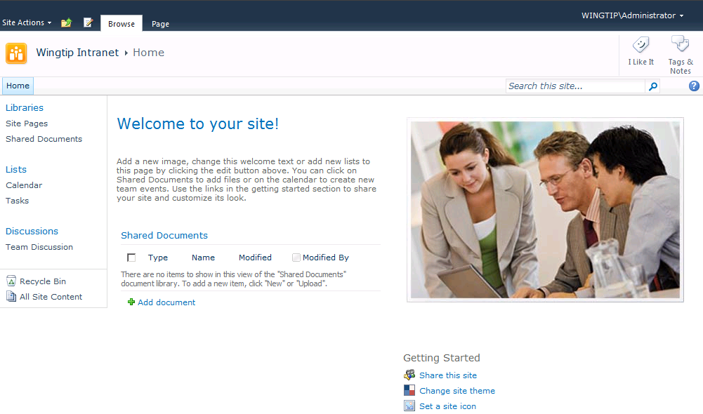
Site Creation and Configuration
Both SharePoint Designer and the browser can be used for most site operations
SharePoint Designer is faster and more efficient
SharePoint Designer
No waiting for server requests
In depth information on the site
Browser
Server post delay for most ops
Browser based limitations
Notes:
Both SharePoint Designer and the browser can be used to create and configure sites. However, since SPD is a client application, it does everything faster and more efficiently. The limitations that exist in the browser are not present in SharePoint Designer (for example, modifying web part zones and making web part connections from one page to another).
Wherever possible, Site Admins and Designers should use SharePoint Designer to create a configure their sites and the components within the sites.

Slide 9
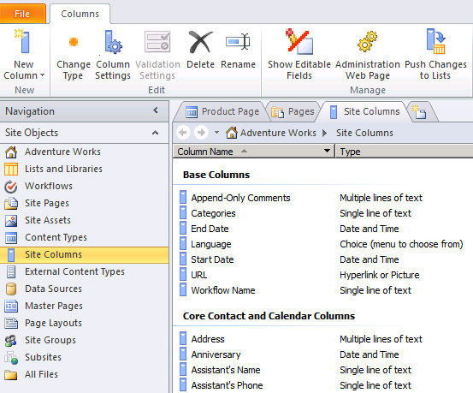
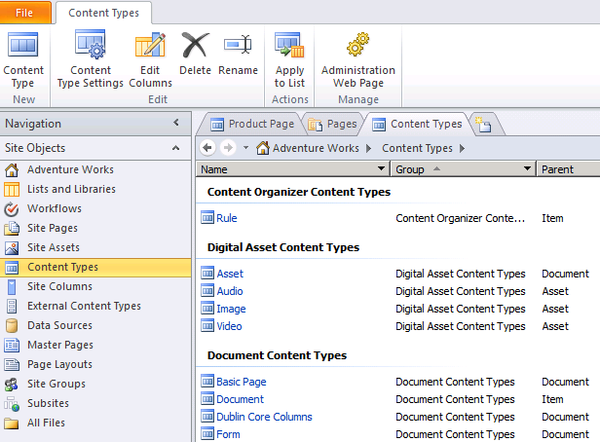
Site Columns and Content Types
Notes:
Reusable column definitions, or metadata templates, are called Site Columns. They can be utilized in multiple lists and libraries through the site and all of the sites that inherit from it.
A content type is used to define a piece of data. It encapsulates all of the settings, information and behavior of an object. Usage of content types helps users define their data throughout the organization in a more meaningful way. They can be utilized in multiple lists and libraries through the site and all of the sites that inherit from it.
Site columns and content types can be created using SharePoint Designer 2010. Create them at the root level site for the ones intended to use throughout the site collection. Create them on a site if only the site and its subsites will use them.

Slide 10
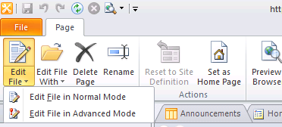
Site Content Modifications
Pages mainly contain the content of the site
Pages can be edited in Normal (Safe) mode or Advanced mode
Use Normal mode as much as possible
Notes:
A site in SharePoint 2010 is essentially a collection of pages. These pages can be modified easily using SharePoint Designer 2010. However, there are a couple of different ways you can access the page: Normal Mode or Advanced Mode.
Normal (Safe) Mode: Most users should only be using safe mode to edit data in pages. This mode ensures that pages are not detached from the site definition which facilitates consistency throughout the site.
Advanced Mode: In advanced mode, a user can change any of the structural components of the page including logos, navigational links, site branding etc. This mode should be utilized carefully as it is as powerful as is dangerous.

Slide 11
Agenda
SharePoint Designer Deployment Plan
SharePoint Designer Permissions
Site Components Creation
Workflows
Site Packaging

Slide 12
Workflow Prototype, Design and Develop
SharePoint 2010 offers new development process
Envision workflows in Visio
Import into SharePoint Designer
Parameterize
Export to Visual Studio 2010
Add code
Visio
SPD
VS10
Notes:
There is a new capability in Visio where it allows you to model a workflow using shapes. You can then export these shapes into SharePoint Designer. Note that SharePoint Designer does not link to the Visio source. Making changes to the Visio sheet after you have imported the sheet into SharePoint Designer does not update the designed workflow.

Slide 13



Workflow Tools Continuum
Visio
SPD
Visual Studio
Rich human workflows
Graphical design
No-code reusability
Flowchart design
Rules design
IW-friendly prototyping
Build activities and pluggable services
Modifications
Farm deployment
Notes:
The creation of workflows can be controlled by several actors within the organization.
Actors: Business Analysts (BA), Site Admins (SA), Developers:
BA: Business analysts usually know the business process best. They can create Workflows using Microsoft Visio.
SA: Site Admins can configure the Workflows with rules, and package it as a *.WSP solution.
Developers: Developers can take over where Admins have left off. They can import the solution in Visual Studio and extend it as necessary.

Slide 14
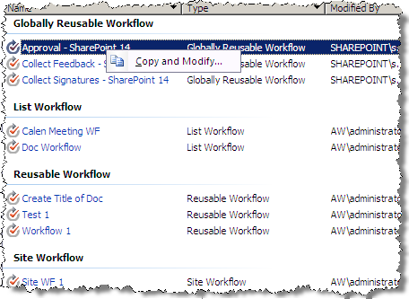
Extend Out Of The Box Workflows
Get a Jumpstart by building on top of the out-of-box workflows
Notes:
The OOTB workflows (Approval, Collect Feedback, Collect Signatures) can all be copied and extended using SharePoint Designer.
Do not modify the original workflow templates that exist at the top level site.

Slide 15
DEMO
Workflow Packaging and Migration

Slide 16
Agenda
SharePoint Designer Deployment Plan
SharePoint Designer Permissions
Site Components Creation
Workflows
Site Packaging

Slide 17
Site Packaging
WSP-based SharePoint application packaging, deployment, and administration
Deploy solution to Server and Client
Artifacts are packaged into a single versioned unit
Solution Package is published to SharePoint
Notes:
When creating a new site, design it in development environment, then package it as a .wsp solution file. Then transfer the solution file to your staging environment and deploy there to test it out. Once ready, you can deploy and activate the solution in production.
Any incremental additions, edits and deletions of any components to the site should not be performed by deploying the whole package again. Deal with each component separately.

Slide 18
DEMO
Site Packaging

Slide 19
Summary
SharePoint Designer Deployment Plan
SharePoint Designer Permissions
Site Components Creation
Workflows
Site Packaging

